Slide 1
Equilibrium Potential
Lab 3

Slide 2
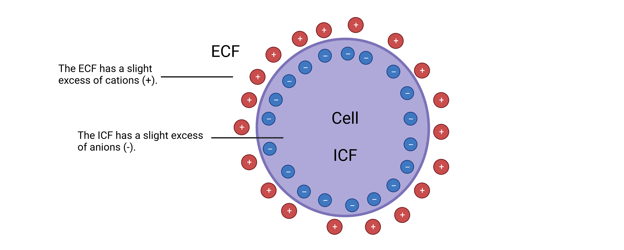
Resting Membrane Potential
In the resting neuron the cytosol along the inside of the membrane has a negative charge compared to the outside. This difference in electrical charge across the membrane is called the resting membrane potential (or resting potential). The action potential is a reversal of this condition, the inside of the membrane briefly becomes positively charged relative to the outside.

Slide 3
Membrane Potential
Membrane Potential – electrical disequilibrium that exists between the intracellular fluid (ICF) and extracellular fluid (ECF) of living cells (V_{m}) caused by the uneven distribution of electrical charge (i.e., ions) between the ECF and ICF
Notes:
intracellular fluid (ICF) and extracellular fluid (ECF)

Slide 4
The Movement of Ions
Ionic movements through channels are influenced by diffusion and electricity

Slide 5
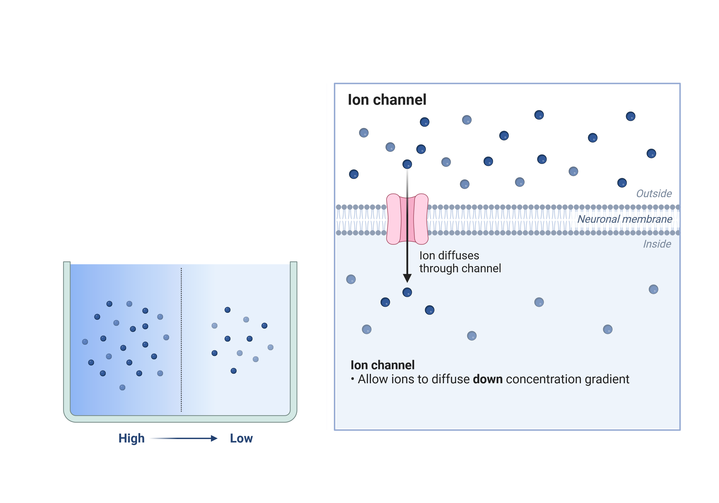
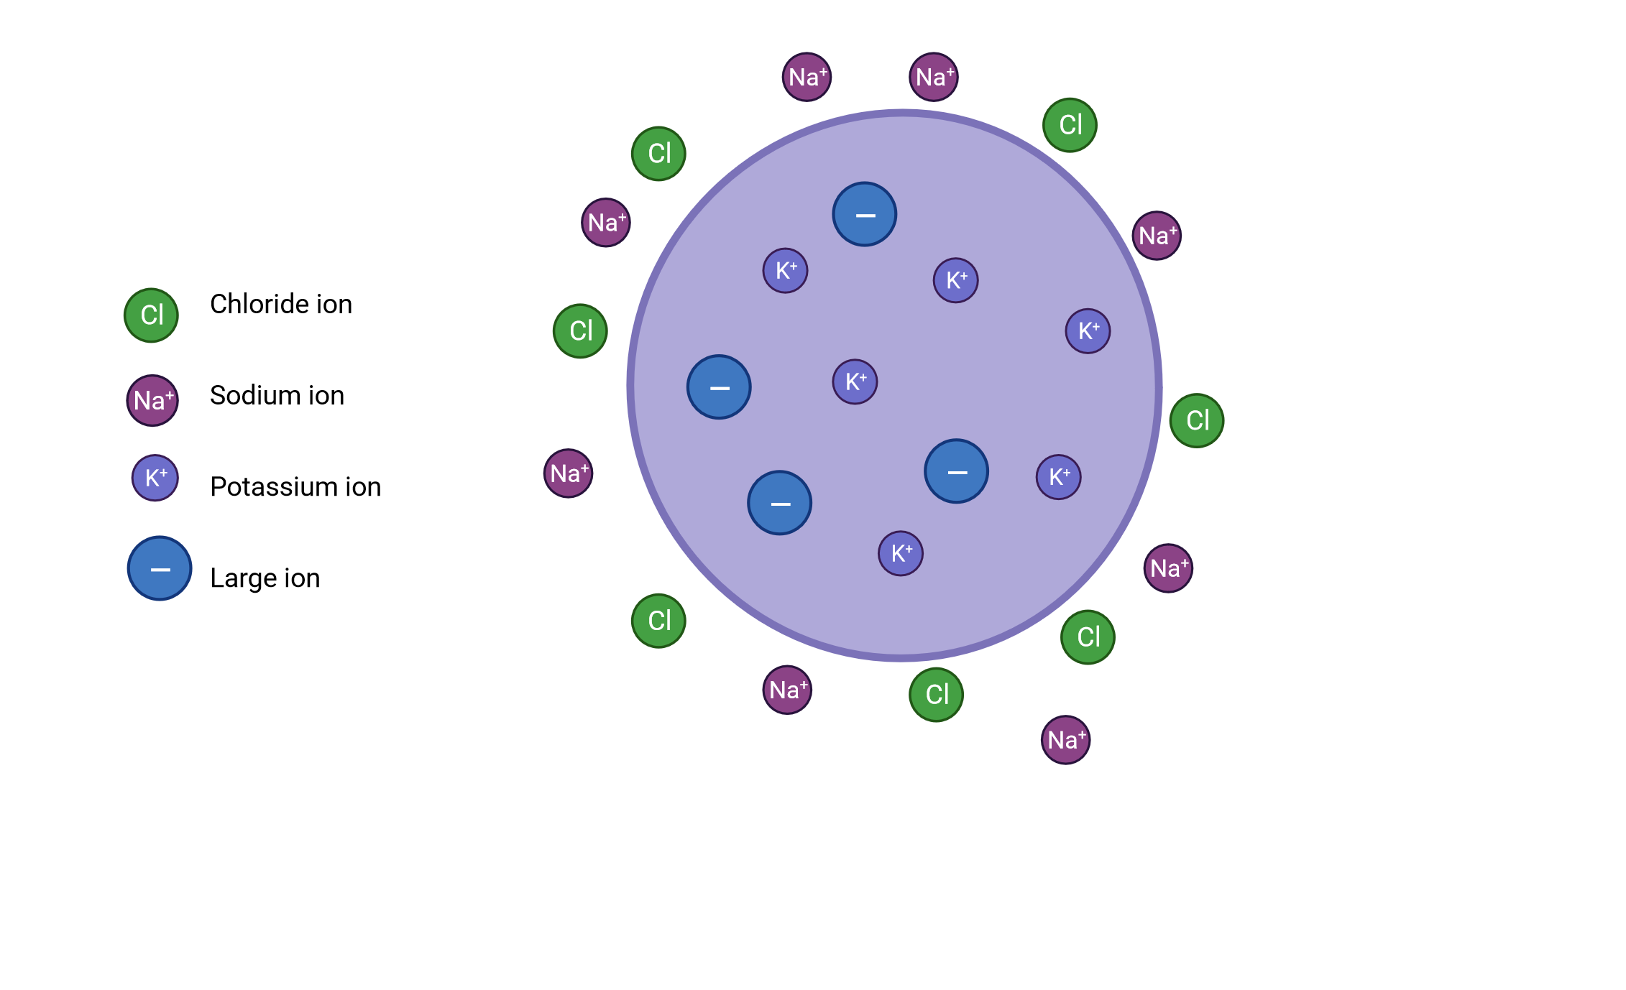
Diffusion
  Ions move from areas of high concentration to areas of low concentration. The difference in concentration is called the concentration gradient.
anion

Slide 6
Electricity
Ions are electrically charged particles: Opposites attract and like charges repel!
Negative charge
Positive Charge
Positive Charge
Negative Charge

Slide 7
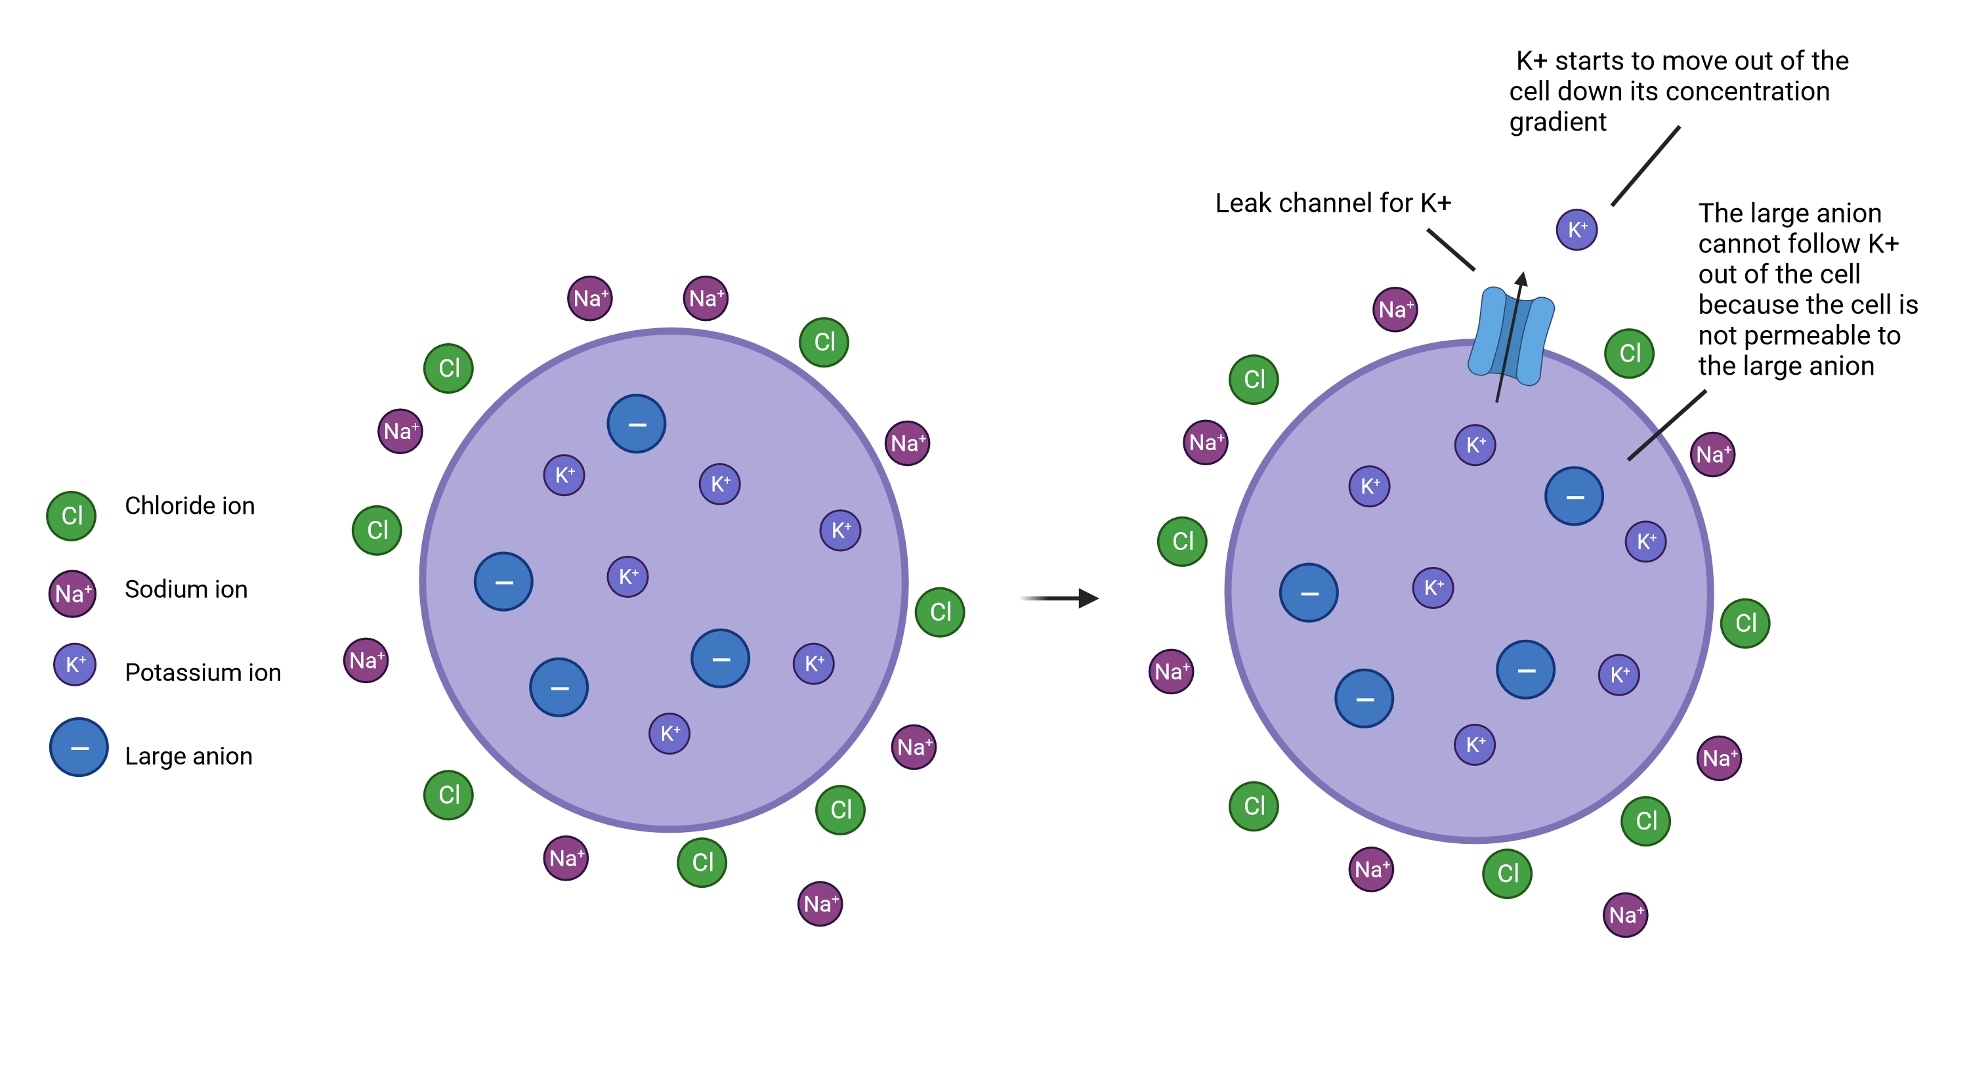
Equilibrium Potential
  A Selectively permeable membrane creates the membrane potential.

Slide 8
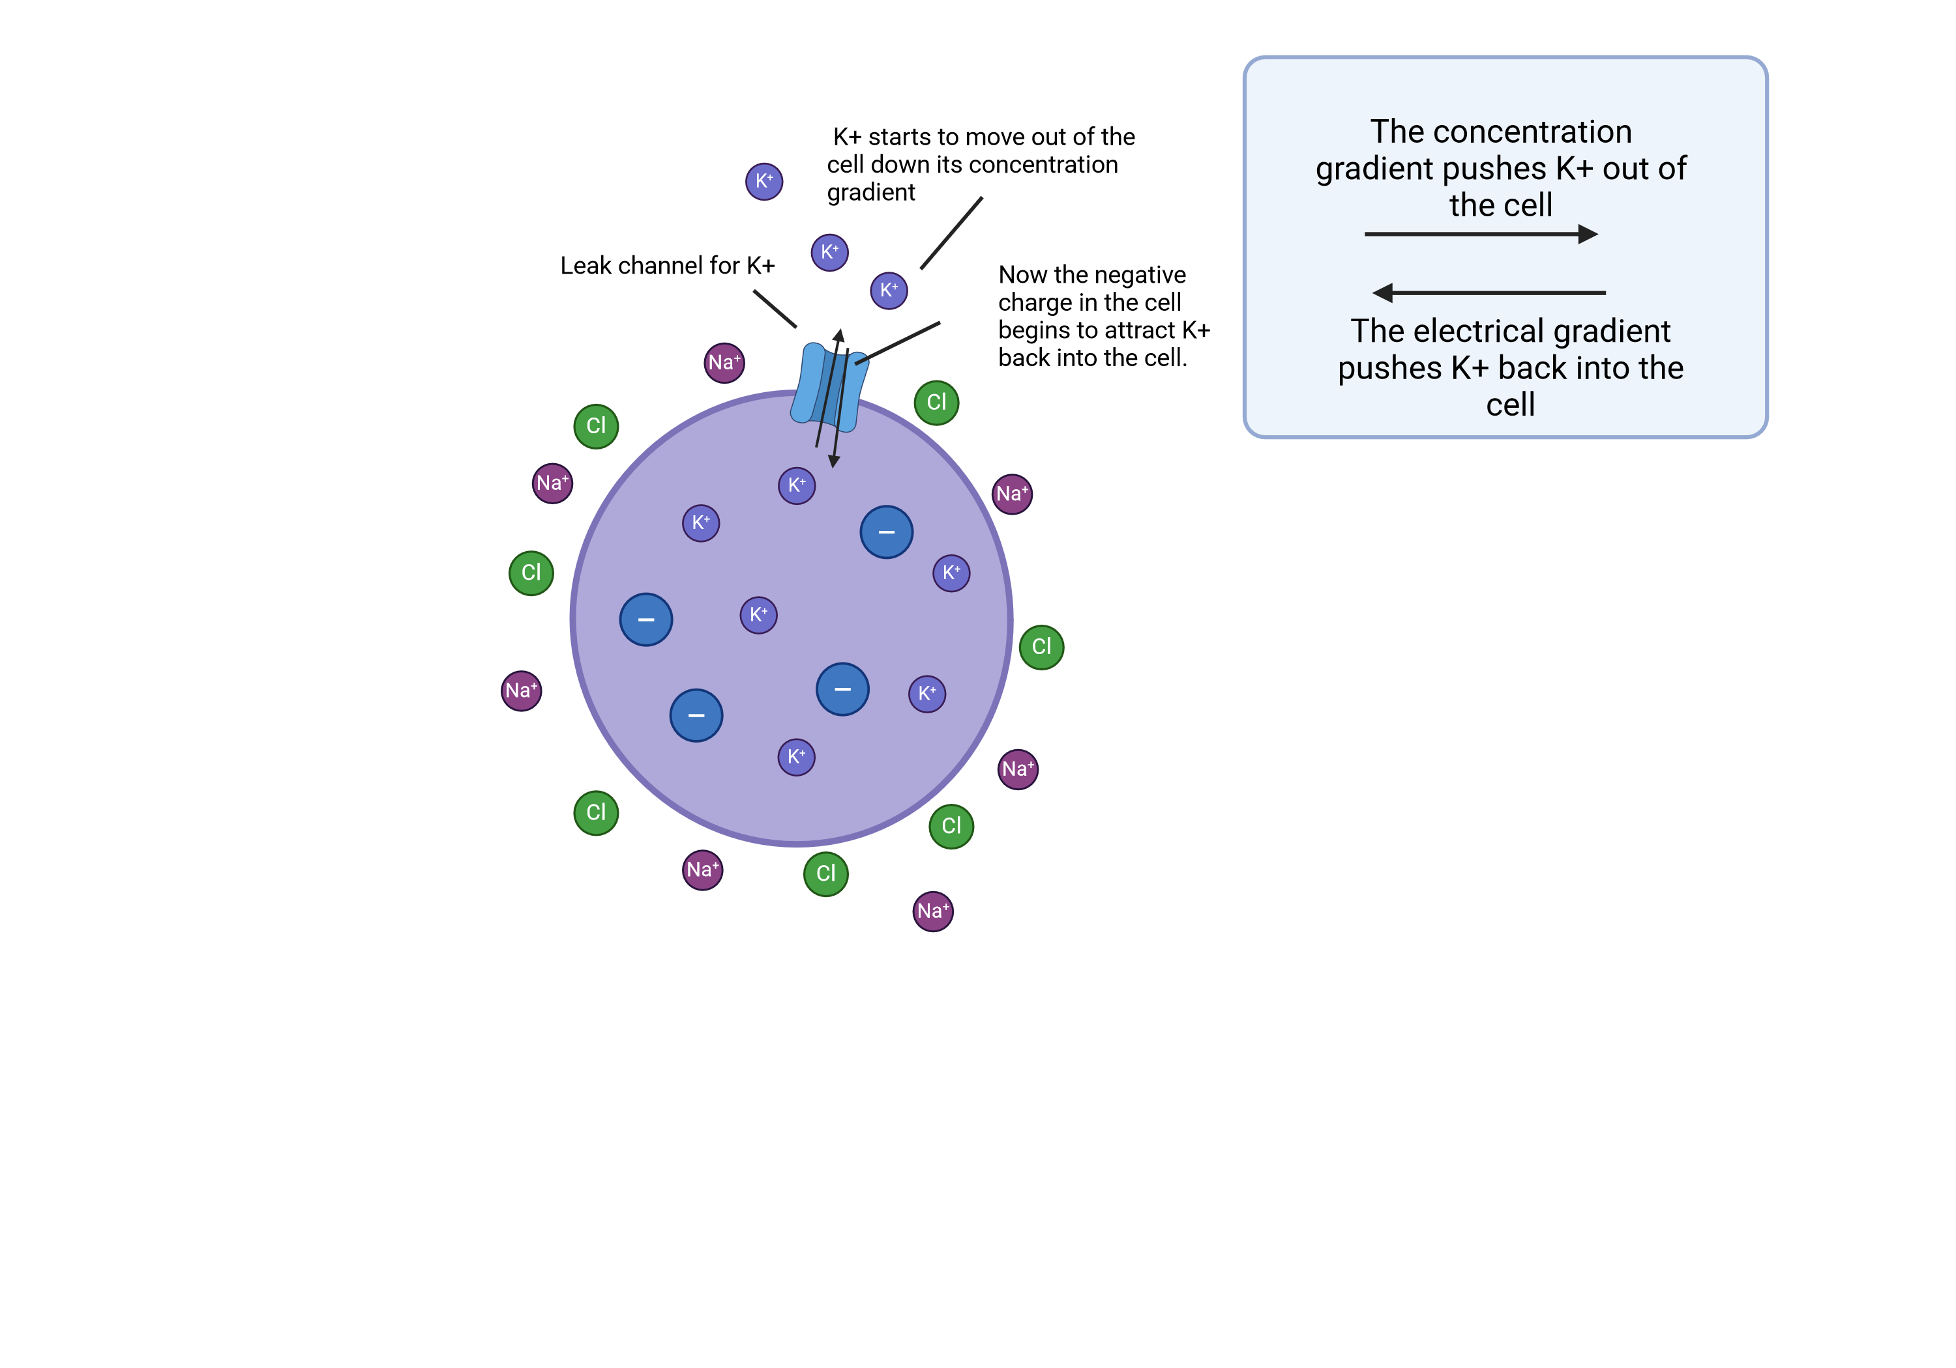
Equilibrium Potential
How much K+ will leave the cell?
  If uncharged, like glucose, would diffuses out until [K]_{out} = [K]_{in}
  But K is + so, must consider electric gradient
  Remember: opposite charges attract, like charges repel
Notes:
As additional K+ ions leave the cell, going down their concentration gradient, the inside of the cell becomes more negative and the outside becomes more positive.

Slide 9
Equilibrium Potential
Electrochemical Equilibrium
  For any given concentration gradient [Ion]out – [Ion]in across a cell membrane, there is a membrane potential difference (i.e., electrical gradient) that exactly opposes ion movement down the concentration gradient
  At this membrane potential, the cell is at electrochemical equilibrium
  There is no net movement of ions across the cell membrane
Notes:
In this example, the concentration gradient sending K+ out of the cell is exactly opposed by the electrical gradient pulling K+ into the cell. This is shown by the arrows that are equal in length but opposite in direction

Slide 10
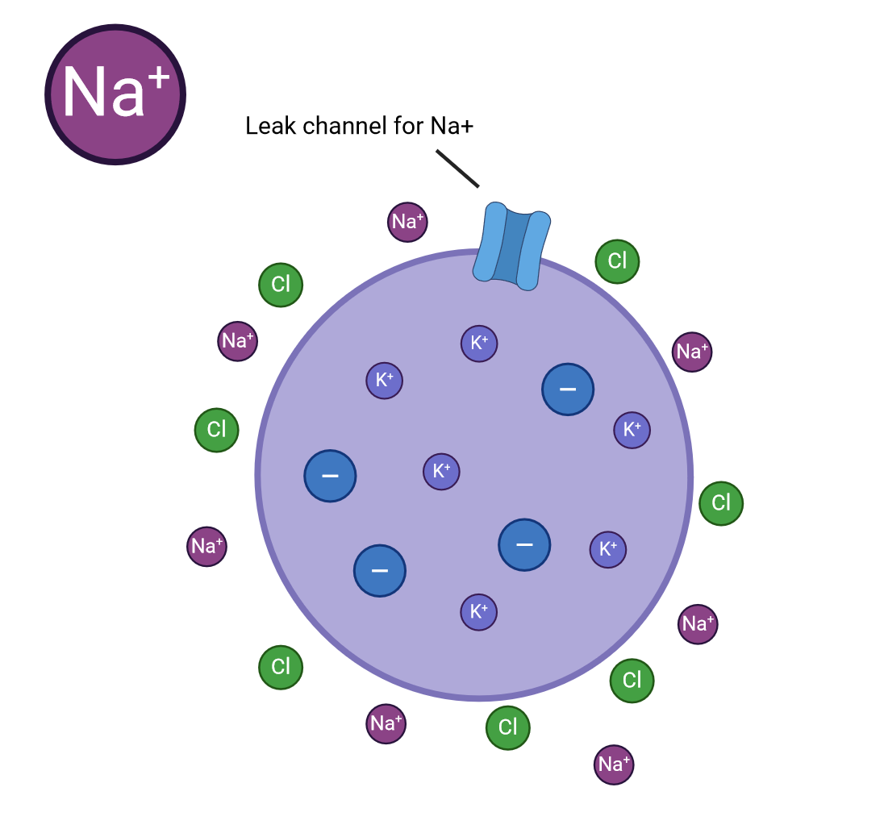
Activity: we insert a leak channel for Na+, what happens?

Slide 11
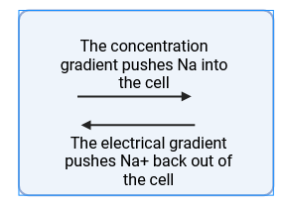
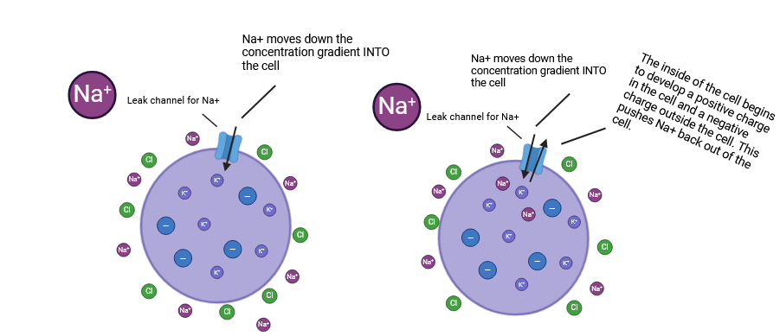
Activity: we insert a leak channel for Na+, what happens?

Slide 12
You do not need to memorize formulas or constants for this lab!

Slide 13
The Nernst Equation
Each ion has its own equilibrium potential- the steady electrical potential that would occur if the membrane were only permeable to that ion.
The exact value of an equilibrium potential can be calculated using the Nernst Equation

Slide 14
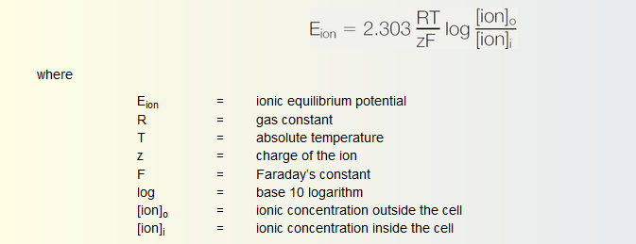
The Nernst Equation
Remember: equilibrium is the balance of diffusion (concentration gradient) and electricity (opposites attract)
Increasing the thermal energy of each particle increases diffusion and therefore increases the potential difference reached at equilibrium : Eion is proportional to T
Increasing the electrical charge of each particle decreases the potential difference needed to balance diffusion: Eion is inversely proportional to the charge of the ion (z)

Slide 15
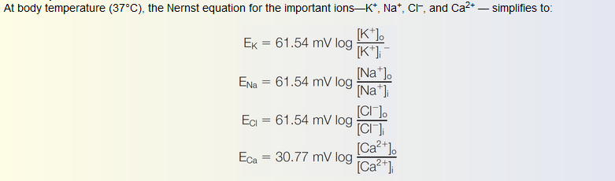
The Nernst Equation
Absolute temp in Celsius
T: 273 +37= 310

Slide 16
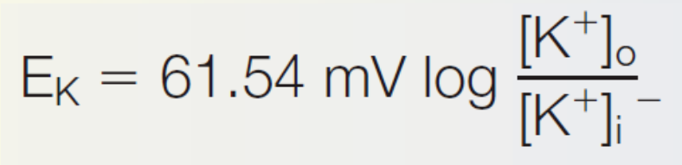
Activity: Calculate Ek if K+ is concentrated twentyfold inside of a cell

Slide 17
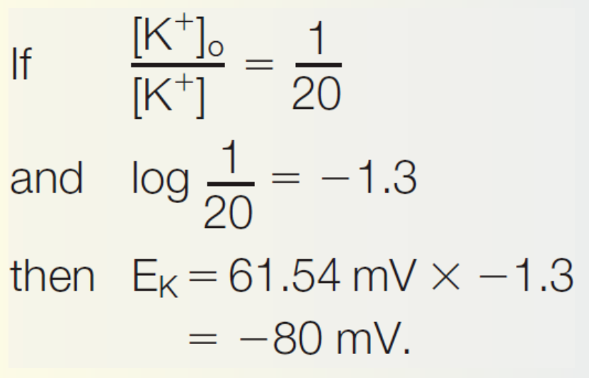
Activity: Calculate Ek if K+ is concentrated twentyfold inside of a cell

Slide 18
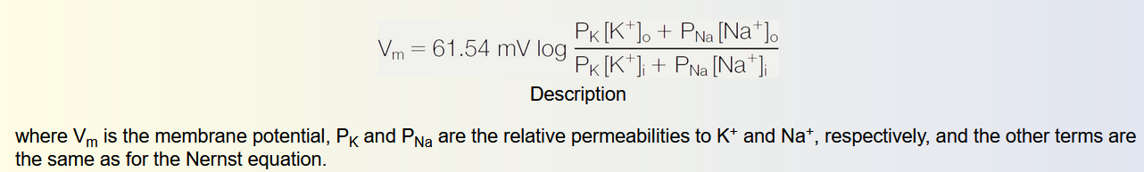
The Goldman Equation
HOWEVER, real neurons are not permeable to only one ion at a time. They are permeable to multiple ions.

Slide 19
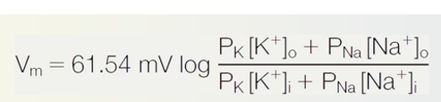
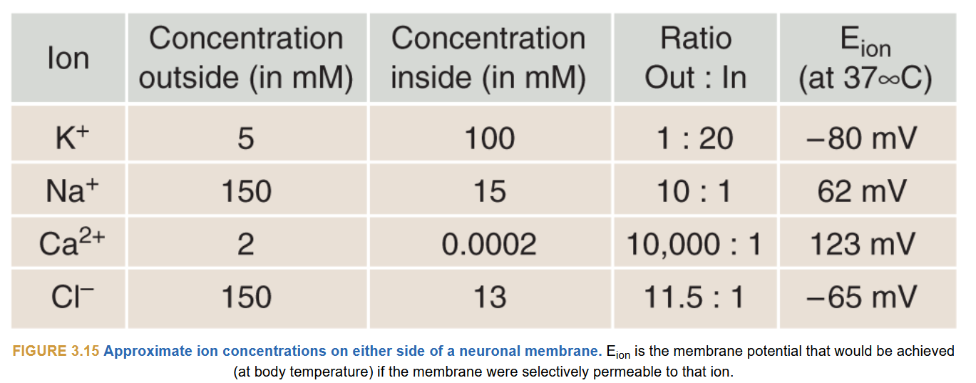
Activity: Using the following table, calculate Vm if K+ ion permeability is 40 times greater than it is to Na+

Slide 20
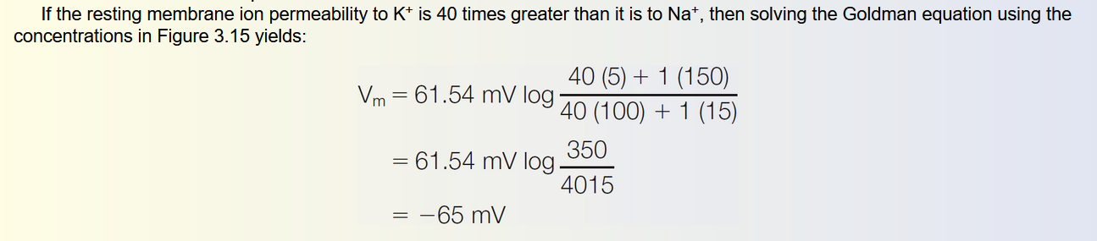
Activity: Using the following table, calculate Vm if K+ ion permeability is 40 times greater than it is to Na+

